Slide 1
PPS Spring Week 1: Pharmacy Apps Crash Course

Slide 2
Pharm School Application Overview
Submit 2 kinds of applications
PharmCAS – general application + materials that will be sent to most schools you apply to (DEADLINE: NOV 1)
Supplementals- Specific to each school, different questions or requirements (DEADLINE: varies by school)
Materials you will need/want
Personal Statement
Official academic transcript (obtain from transcript office)
Resume
Letters of Recommendation
1 Professor
1 Pharmacist
1 Other (Can be another professor or pharmacist also)

Slide 3
www.pharmcas.org
Application period: July -March
Notes:
You can make an acc starting July 14. Complete PharmCAS by Nov 1.

Slide 4
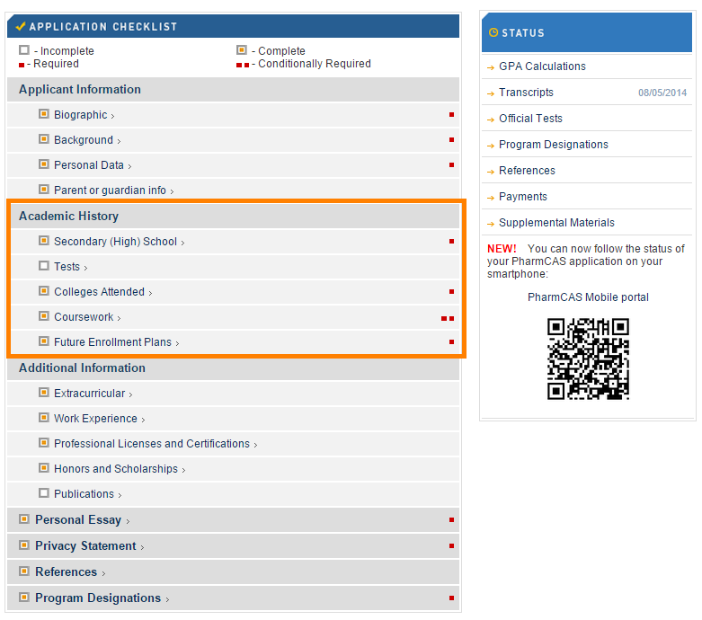

Slide 5
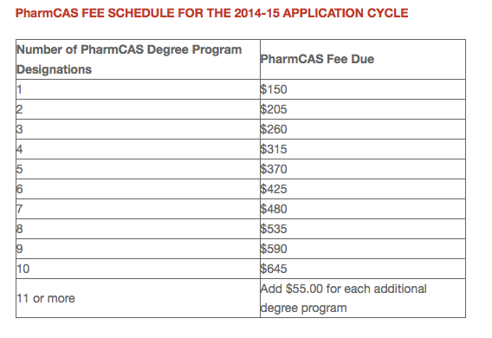
Application Costs
Expenses:
PharmCAS
Supplemental (varies by school)
UCSF, UCSD: $90
USC: free
UOP: $60
Traveling costs for interviews

Slide 6
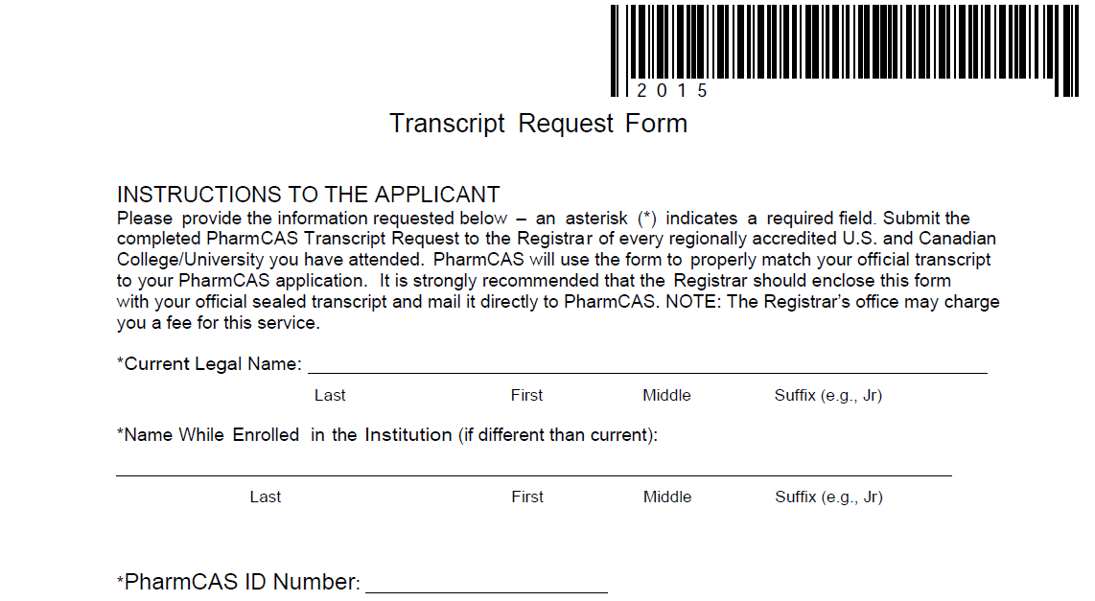
Ordering Transcripts
2 Forms:
Transcript Request Form (PharmCAS)
UCLA Transcript Order Form
http://www.registrar.ucla.edu/forms/transcript.pdf
Process
Submit to Murphy Hall ($0)
Check status online
Obtain unofficial copy
Tip: Order it as soon as Spring 2016 grades are available!
Notes:
It will take PharmCAS ~4 weeks to verify your transcript, so you want to send it in ASAP so they already have it when you submit your PharmCAS application.

Slide 7
Extracurricular Tips
Quality over quantity
Participate in activities that are meaningful to you - does not all have to be health or pharmacy related
Get leadership experience!
FAQ: Is having research experience necessary?
Answer: No. Doing research is great, but research is not for everyone. Spend your time on activities you are passionate about
To obtain pharmacy experience - aim to get your pharmacy technician license early on so you have more work and volunteering opportunities

Slide 8
PharmCAS Tips
Once you are ready to submit, keep in mind that there will be waiting time for verification before it will be sent to the schools. (+ time it takes for them to receive your transcript)
You can only submit PS once (through PharmCAS) and this goes to ALL the schools
Supplementals are separate and are only submitted to the specific school you apply to
Rolling vs non rolling schools
Early Decisions

Slide 9
References
Once your references agree to write your letter of recommendations and PharmCAS is available, obtain their email address and phone number and input it into PharmCAS. PharmCAS will then send them a link for their letters.
All electronic!
*Don’t use the Career Center rec letter service unless the pharmacy school you’re applying to doesn’t use PharmCAS

Slide 10
Letter of Recommendations Tips
Most schools require 3 rec letters (up to 4)
one science professor
the rest are up to you - pharmacist (required by UOP), lab PI, employer, club adviser, etc
Start thinking about who you want to ask at the beginning of your 3rd year
The sooner you ask them, the better
Ask them now, but let them know you’ll be able to send them the PharmCAS link in June
Set fake deadlines!
Have resume and personal statement ready

Slide 11
Supplemental Applications
Example prompts:
Why this school?
Elaborate on leadership in one of your extracurricular activities.
What unique qualities can you bring to our program?
What is the human condition?
Notes:
Grammar, active voice, be intentional with the limited space, no flowery writing- express the main point

Slide 12
Supplemental Application Tips
USC and UOP require a resume
Resume critique service at Career Center
Work on applications with rolling deadlines first
Many schools ask similar essay prompts
Create a list to see which topics overlap
Can have basic essay skeleton that you personalize and modify for each school
For each school, look at all your essays as a whole
Is there repetition between essays?
Do all my essays together paint a diverse picture of me? Have I showcased my individuality and different aspects of my character?

Slide 13
Interviews
Interview Day is typically 5-6 hours long total ( Interview, Campus Tour, Presentations, Essay, etc)
Most interviews are scheduled on Fridays (esp for CA schools) or Saturdays.
→ Try to arrange your class/work schedule to be flexible for Fridays!
Depending on the school, rescheduling interview dates may be an option
October- March
Notes:
The time depends on if it’s rolling or not. If not rolling, its pretty random how they select people for certain dates. Some are school days, some are not (Friday or Saturday). Some schools cannot reschedule interviews- so be aware of that!

Slide 14
Types of Interviews
The traditional interview
15-30 minutes
Formal
Often two interviewers
Close File vs Open File
Notes:
MMI- UCSF = only in state school that currently uses it. It is, however, spreading.

Slide 15
Types of Interviews
Multiple mini interview (MMI)
A series of short, timed scenario- based questions.
Used to evaluate a candidate’s personality and character
Notes:
MMI- UCSF = only in state school that currently uses it. It is, however, spreading.

Slide 16
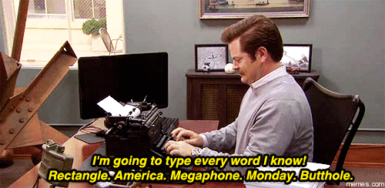
On Site Essay
Tests written communication skills
Tests ability to form an opinion and take a stance
Requires no prior research/knowledge
Not much preparation can be done
Know essay paragraph format
Know how to express your thoughts clearly and concisely
Be wary of time limit
NOT every school has this though! :)

Slide 17
Interview Preparation
Research the school ( School mission, programs, etc)
Know how you want to convey yourself
Mock interviews
Write down your answers or make outlines
Review your PS, supplementals

Slide 18
Potential Questions
How do you handle stress?
Do you have any questions for us? (Have one ready!)
Be careful to have questions that you cannot find an answer online already
School specific
Why this school?
What are the strengths & weaknesses of this school?
Pharmacy
Why pharmacy?
What are some challenges in pharmacy?
What do you see as the future of pharmacy?
Situational
Can you tell us of a time you faced an obstacle, and what you did to overcome it?

Slide 19
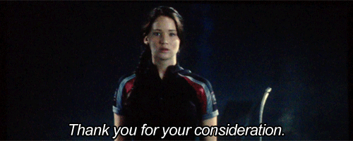
Interview Tips
Think about your experiences and what you have learned from them
Example: working in a pharmacy
Tell me about a time where you demonstrated leadership/worked in a team
Tell me about a time where you used creativity to solve a problem
What are the most important attributes/qualities of a leader/pharmacist?
Describe a time where you had a difficult situation with another person and how you handled it

Slide 20
Interview Tips
On the day of:
BE ON TIME
Plan meals so you’re not hungry and tired throughout the day (some schools provide lunch, snacks, water)
Bring ID & other required forms

Slide 21
Hearing Back
Depends on the school
1 week - 2 months
Deposit to secure spot
1 week - 1 month
Tip: to save $, apply strategically to rolling schools so you don’t have to end up depositing more than necessary

Slide 22
Out of State - Why should I apply?
Diverse experiences!
Exposure to new environments, new people, new cultures could continue to help you grow as a person
Wide array of options
As of July 2015 - 132 U.S. Pharmacy schools
8 in California
Top 50 - USC, UCSD, UCSF from Cali
Tuition could be cheaper!

Slide 23
In vs. Out of State Considerations
Things to consider:
Location - How far from home?
Tuition - $$$$
Experiences - Can you grow from this?
Preferences - What do you want in your school?
Cost of Living
Job Opportunities
Find these out by:
Talking with current students
Visiting the campus in person
Searching online

Slide 24
Pharm School Rough Tuition Breakdown
School | Room and Board | Tuition (per year) | Financial Aid
USC | 16,300 | 50,800
UCSD | 10,100 | 36,600
University of Washington | 11,000 | 50,286 → 28,000
University of Michigan | 11,000 | 45,000 | 15k (6.5 + 8.5)
UCSF | 22,680 | 37,000
Western | 17,000 | 47,500

Slide 25
In State vs. Out of State:Tuition Summary
School | 4 Year Cost
USC | 268,000
UCSD | 186,800
UW | 244,800 (178,000)
UM | 209,000
USCSF | 239,000
Western | 258,000

Slide 26
Useful Resources
www.pharmcas.org
www.studentdoctor.net
www.pharmacyschooladmissions.blogspot.com
www.pharmdadmissions.ucsf.edu
http://grad-schools.usnews.rankingsandreviews.com/best-graduate-schools/top-health-schools/pharmacy-rankings
Pre-Pharmacy Society at UCLA

Slide 27
General Advice/Tips
Ricky
Thuy
Questions????

